Slide 1
Deep Learning
Contents
Characteristics of ANN
Back propagation
Gradient Descent

Slide 2
Artificial Neural Networks
ANN is based on the collection of connected units called Artificial Neurons.
Each connection between artificial neurons can transmit a signal from one to another.
The artificial neuron that receives the signal, process it ,then transmit to the neighboring neurons.

Slide 3
Characteristics of ANN
Activation function : This function defines how a neuron’s combined inputs are transferred into a single output signal.
The network topology
  It describes the number of neurons in the model as well as the number of layers and the way they are connected.
  It determines the complexity of the task.

Slide 4
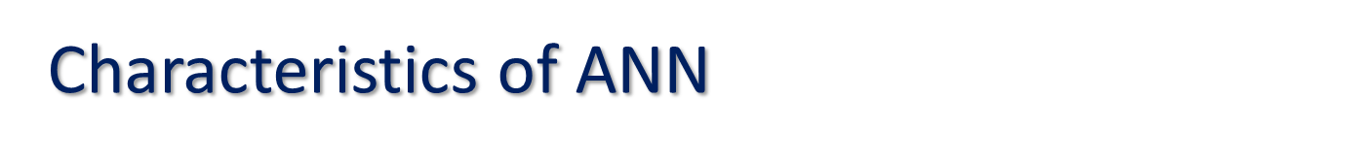
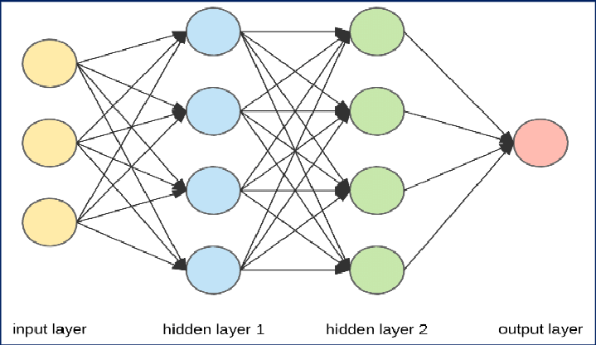
Different forms of topology can be differentiated by the following characteristics :
The number of layers.
Input nodes(first layer) : The nodes that receive unprocessed signals directly from the input data.
Hidden nodes(second layer) : The nodes that processes the signals from the input node prior to reaching output nodes.
Output nodes : Those nodes that generate the final predicted values.

Slide 5
b) Whether information in the network is allowed to travel backward.
Feed forward network : Network in which input signal is fed continuously in one direction from connection to connection until it reaches the output layer called feed forward network.
Feedback network : Network which allows signals to travel in both directions using loops are called feedback network/recurrent network.

Slide 6
c) The number of nodes within each layer of the network
The number of features in the input data => Number of input nodes.
Number of output nodes => Number of outcomes to be modeled.
Number of hidden nodes => User to decide prior to training the model. The appropriate number depends on number of input nodes, amount of training data, amount of noisy data, complexity of learning task etc.

Slide 7

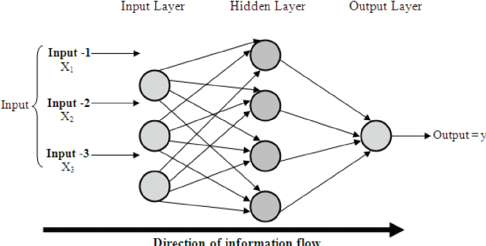
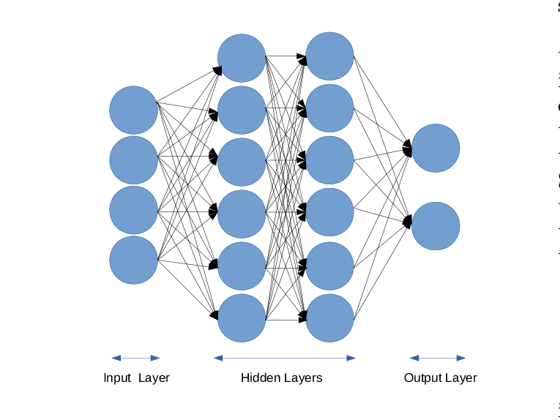
Network with 2 hidden layer
Network with 1 hidden layer
Network with 2 hidden layer and 2 output nodes

Slide 8
3) Training algorithm
Algorithms specifies how connection weights are set in order. Mainly 2 algorithms for learning a single perceptron.
Perceptron rule : used when training dataset is linearly separable.
Delta rule : used when training data set is not linearly separable.

Slide 9
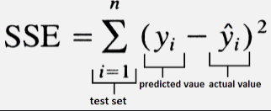
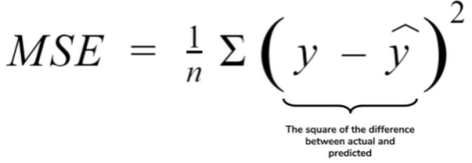
4) Cost Function:
It is a function that measures the performance of a model for given data. Also called the loss function/ objective function/scoring function/error function.
Let y be the output variable. y₁,y₂,…y_{n} are actual values of y. Also ŷ₁, ŷ₂,….. ŷ_{n} are predicted values
SSE : Sum of squares of differences between predicted and actual values of y denoted by
MSE : Mean of the sum of squares of the differences between the predicted and actual values of y denoted by

Slide 10
Back propagation
Back propagation is an algorithm for supervised learning of artificial neural networks using gradient descent.
Given an artificial neural network and an error function, the method calculates the gradient of the error function with respect to the neural network weights.

Slide 11
Back propagation
Initially the weights are assigned at random.
The algorithm iterates through main cycles of to process called
  Forward phase
  Backward phase
A Forward Phase : Neurons are activated in sequence from the input layer to the output layers. Applying neuron’s weights and activation function along the way an output signal is produced from the final layer.
A Backward phase : Output signal combined with the true target value. Difference in results i.e.. error is propagated backward in the network to modify the connection weights

Slide 12
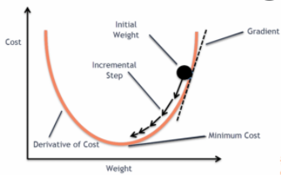
Back propagation
3) The technique used to determine how much a weight can be changed is known as Gradient Descent method.
At any point on the surface of the curve the gradient suggest how steeply the error will be reduced or increased for a change in the weight.
Algorithm helps to change the weights that result in the greatest reduction in error

Slide 13
Gradient Descent
Imagine a blindfolded man who wants to climb to the top of a hill with the fewest steps along the way as possible. He might start climbing the hill by taking really big steps in the steepest direction, which he can do as long as he is not close to the top. As he comes closer to the top, however, his steps will get smaller and smaller to avoid overshooting it. This process can be described mathematically using the gradient. Instead of climbing up a hill, think of gradient descent as hiking down to the bottom of a valley.
WHAT IS A GRADIENT?
In machine learning, a gradient is a derivative of a function that has more than one input variable known as the slope of a function.In mathematical terms, the gradient simply measures the change in all weights with regard to the change in error.

Slide 14
Gradient Descent
Gradient Descent is an iterative optimization algorithm for finding the local minimum of a function.
To find the local minimum of a function using Gradient Descent, take steps proportional to the negative of the gradient( move away from the gradient ) of the function at the current point.
It takes steps proportional to the positive of the gradient ( moving towards the gradient ), we will approach a local maximum of the function. This procedure is called gradient ascent.

Slide 15
Gradient Descent
The goal of the gradient Descent algorithm is to minimize the given function.
1) Compute the gradient(slope), the first order derivative of the function at that point.
2) Make a step in the direction opposite to the direction of the gradient.
We have now in the direction to move in, next is to decide the size of the step.
Learning rate (ɳ)– A tuning parameter in the optimization process and it decides the length of the steps.

Slide 16
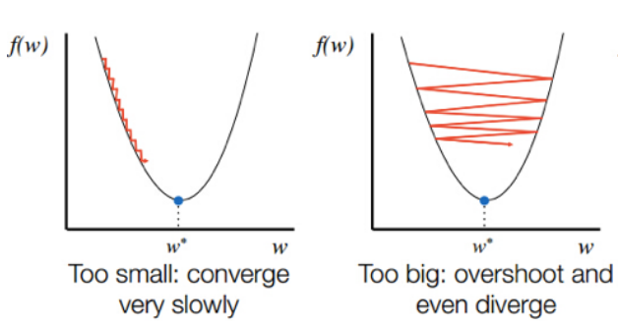
Gradient Descent
If the learning rate is too high it might overshoot the minima and keep bouncing without reaching the minima.
If the learning rate is too small the training might turn out to be too long.
Choose an optimal learning rate so that model converges to the minimum.

Slide 17
Types of gradient Descent:
Batch Gradient Descent: This is a type of gradient descent which processes all the training examples for each iteration of gradient descent. But if the number of training examples is large, then batch gradient descent is computationally very expensive and not preferred. Instead, we prefer to use stochastic gradient descent or mini-batch gradient descent.
Stochastic Gradient Descent: This is a type of gradient descent which processes 1 training example per iteration. Hence, the parameters are being updated even after one iteration in which only a single example has been processed. Hence this is quite faster than batch gradient descent. But again, when the number of training examples is large, even then it processes only one example which can be additional overhead for the system as the number of iterations will be quite large.
Mini Batch gradient descent: This is a type of gradient descent which works faster than both batch gradient descent and stochastic gradient descent. Here b examples where b<m are processed per iteration. So even if the number of training examples is large, it is processed in batches of b training examples in one go. Thus, it works for larger training examples and that too with lesser number of iterations.

Slide 18
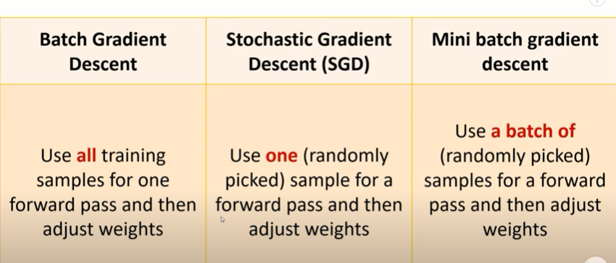
Types of gradient Descent:

